Slide 1

Optimized Warehouse Management of Perishable Goods for a Food Delivery Company
IBM HACK CHALLENGE 2020

Slide 2
DETAILS
Application ID: SPS_CH_APL_20200003067
Project ID: SPS_PRO_1511
Project Title: Optimized Warehouse Management of Perishable Goods for a Food Delivery Company
Challenge Title: IBM Hack Challenge 2020
Start Date: 06/08/2020

Slide 3
INTRODUCTION
WITH THE POPULARIZATION OF ONLINE SHOPPING AND THE IMPROVEMENT OF DELIVERY SERVICE, MORE AND MORE CUSTOMERS BUY PRODUCTS ON BUSINESS-TO-CUSTOMER (B2C) PLATFORMS. HOWEVER, STORAGE OF PRODUCTS AND RISK OF WASTAGE ARE TWO CRITICAL FACTORS AFFECTING FOOD DELIVERY COMPANIES IN B2C EXPERIENCE. THUS, IT IS AN IMPORTANT ISSUE TO COME UP WITH SOME SUITABLE AND OPTIMIZED WAREHOUSE MANAGEMENT SYSTEM FOR ANY FOOD DELIVERY COMPANY.
THIS WEBSITE PROVIDES 2 SERVICES :
CUSTOM PREDICTION FOR 1 WEEK ACCORDING TO DATA ENTERED.
10 WEEK PREDICTION FOR ORDERS IF CENTER ID AND MEAL ID IS GIVEN.

Slide 4
EXISTING PROBLEM
A food delivery service has to deal with a lot of perishable raw materials which makes it all, the most important factor for such a company is to accurately forecast daily and weekly demand. Too much inventory in the warehouse means more risk of wastage, and not enough could lead to out-of-stocks - and push customers to seek solutions from your competitors. The replenishment of the majority of raw materials is done on a weekly basis and since the raw material is perishable, the procurement planning is of utmost importance.

Slide 5
PROPOSED SOLUTION
This is a Regression Problem as the client has to forecast the no of orders for upcoming week for a center.
Our solution consists of creating a website through which all the new data can be uploaded for further analysis (Continuous updation of data for improving results).
For creating a model, first we will preprocess the data which is given to us.
Then for the training and testing set, we will merge the data with the Meal and Region file.
Then by feature engineering, we will remove the columns which will negatively affect the result by observing their correlation or columns which are not useful enough in prediction.
We can also derive some new columns from the existing columns which can give us better results.
We will build and test various Regression models to find which model gives high accuracy and use that model.
The result will be used to find the category and type of food and create a procurement plan for clients for effective procurement of every category of raw material.

Slide 6
THEORETICAL ANALYSIS
SOFTWARE DESIGNING
Alternate methods used :
Random Forest Algorithm, Linear Regression, Light GBM Models were used for prediction which had lower accuracy as compared to Extra Trees Regressor Algorithm which is currently in use.
Languages : HTML, CSS, Javascript, Python.
Frameworks : Bootstrap
Library/ Models : Fbprophet ,Extra Trees Regressor
Cloud Services : IBM Cloud ,IBM Watson, Node-RED

Slide 7
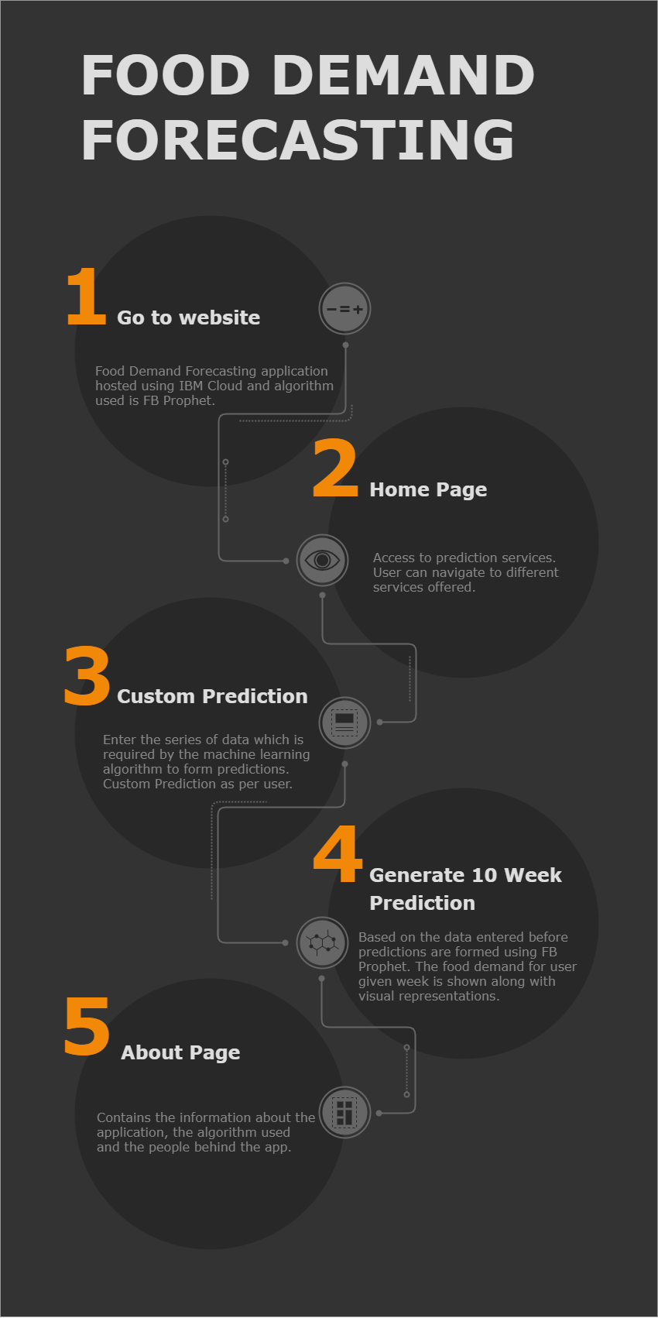
FLOW DIAGRAM

Slide 8
EXPERIMENTAL INVESTIGATION
During the project creation, we have to search about a lot of things. This was a great learning experience for the team since by doing this we learned about various concepts and technologies like:
Various Machine Learning models like LightGBM, Random Forest, etc.
Time Series models and forecasting.
FBProphet
Node-Red
IBM Cloud
IBM Watson
IBM Auto AI

Slide 9
PROJECT SCREENSHOTS

Slide 10
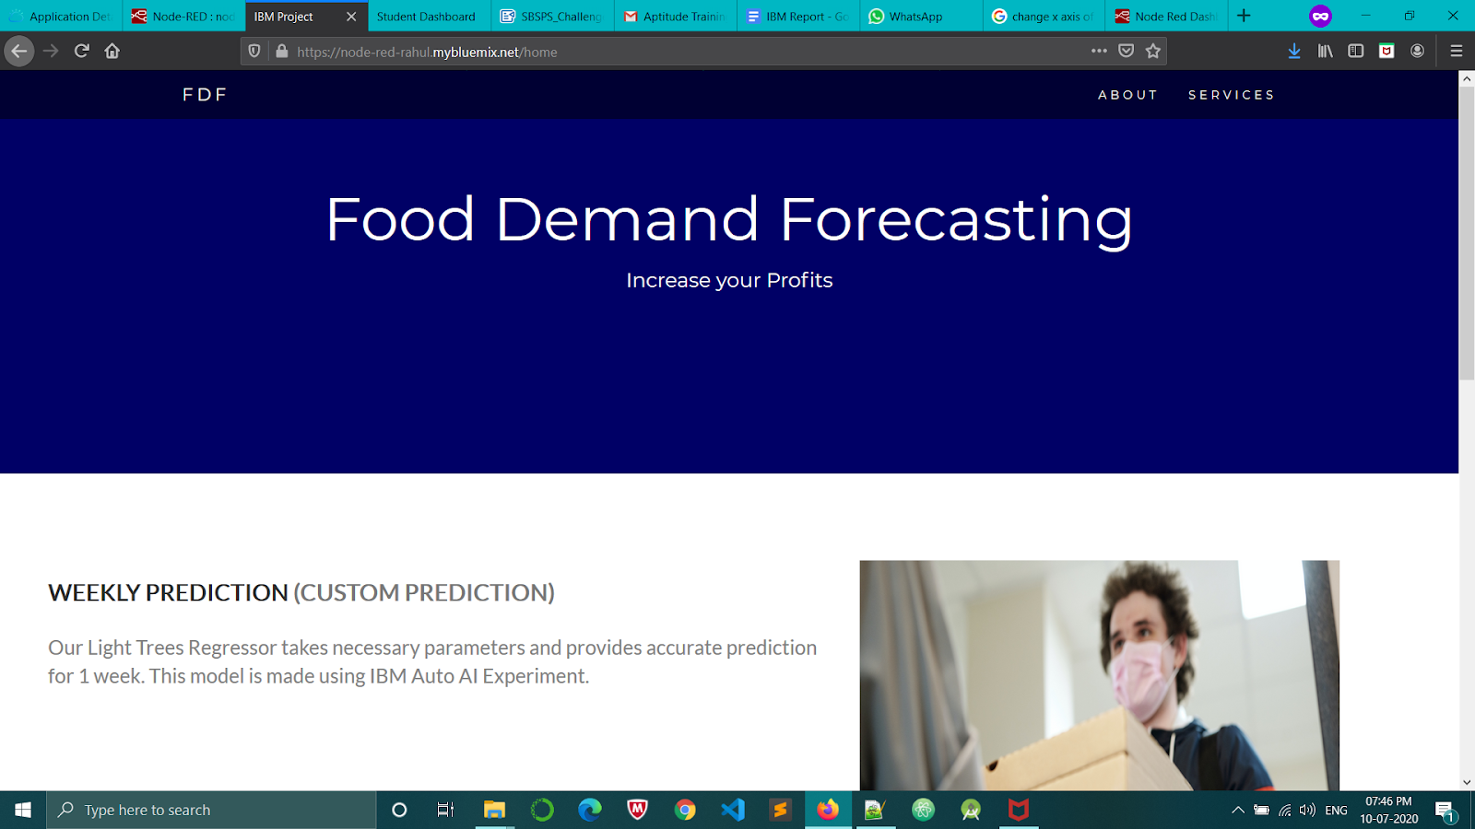
HOME PAGE

Slide 11
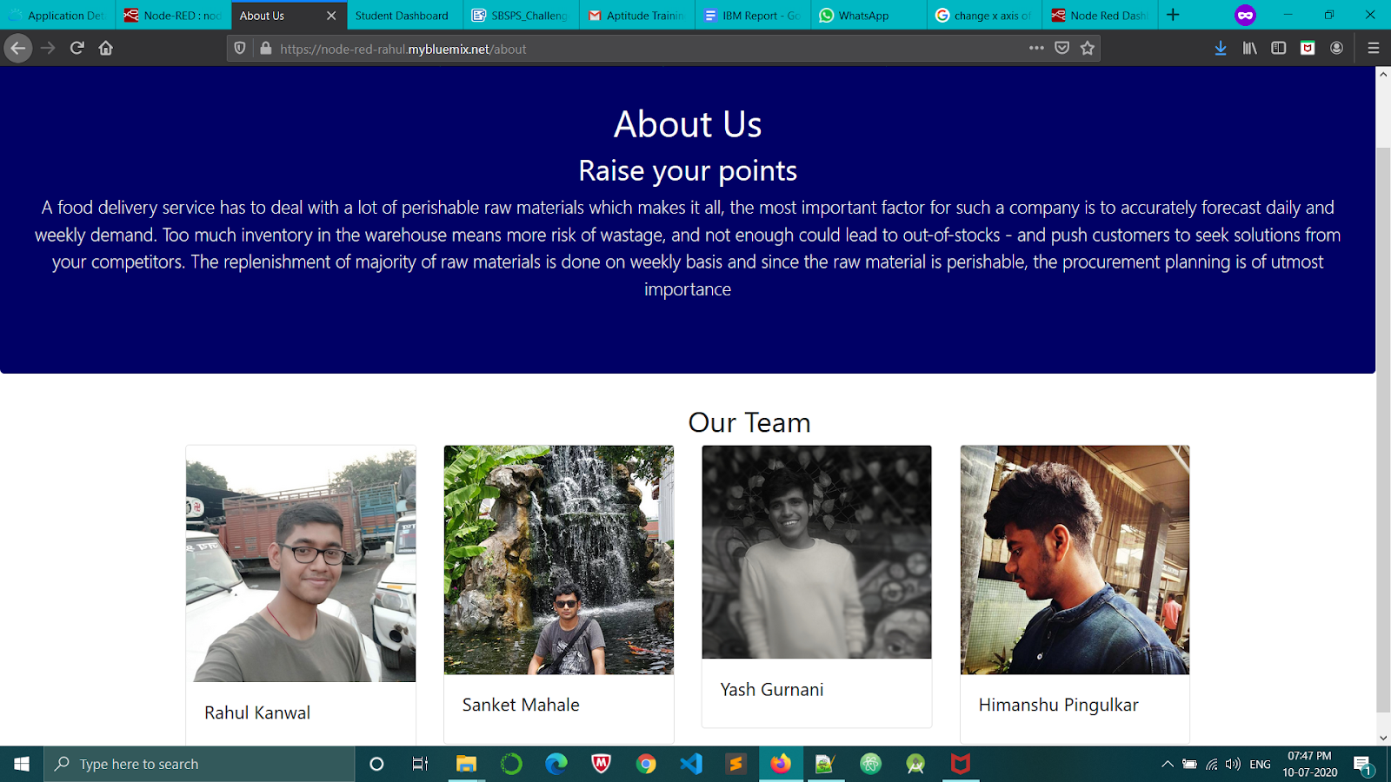
ABOUT US PAGE

Slide 12
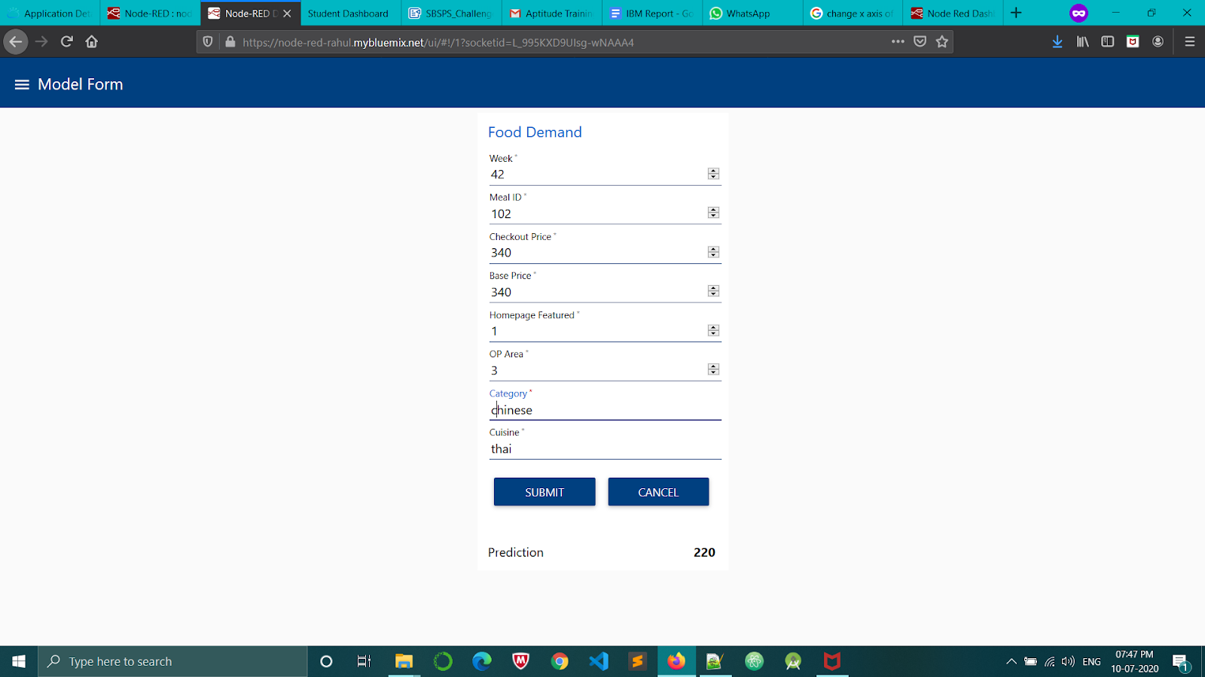
PREDICTION PAGE

Slide 13
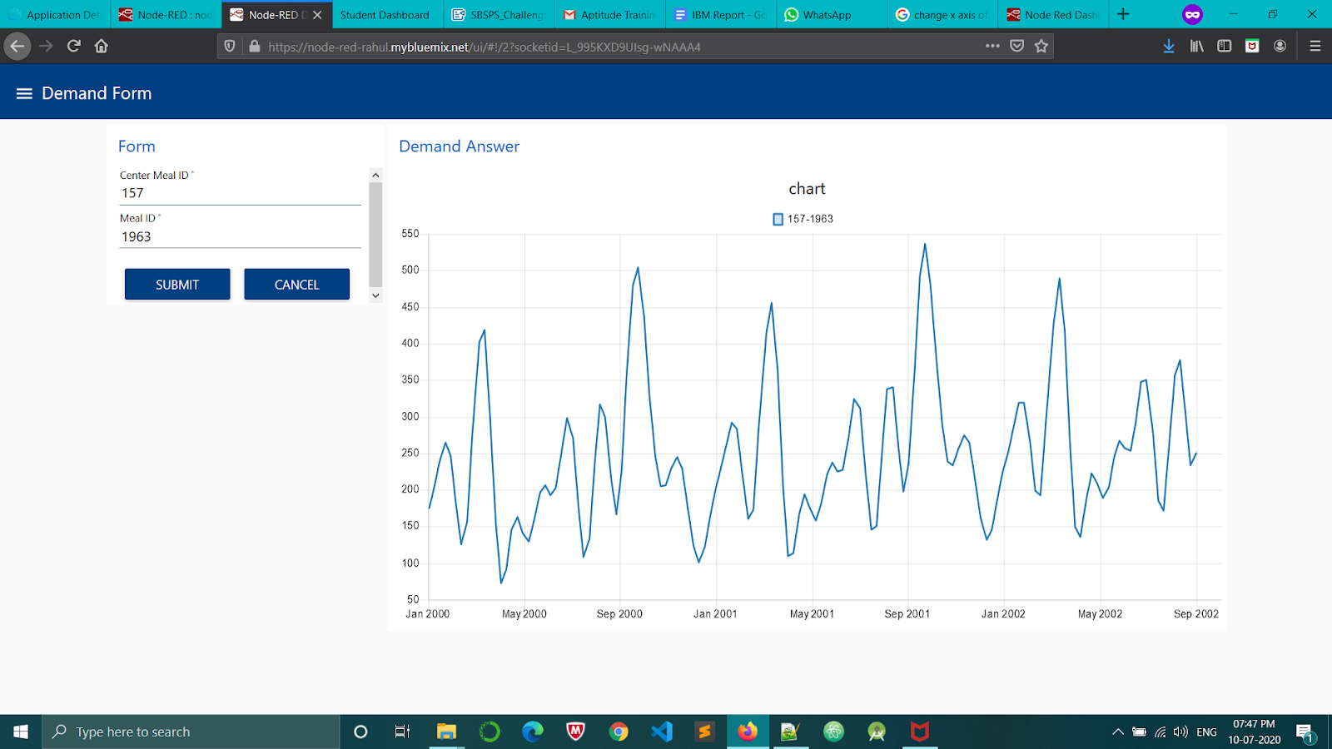
TIME SERIES PAGE

Slide 14




TEAM MEMBERS
RAHUL
KANWAL
SANKET
MAHALE
YASH
GURNANI
HIMANSHU PINGULKAR

Slide 15
LITERATURE SURVEY
Problem Readings: https://www.altexsoft.com/blog/demand-forecasting-methods-using-machine-learning/ Kaggle dataset: https://www.kaggle.com/kannanaikkal/food-demand-forecasting?select=train.csv Youtube Reference: https://www.youtube.com/watch?v=WF67aQ09hPA Using Node-RED : https://youtu.be/iEadmCNb_hE
Article about Time Series:
https://towardsdatascience.com/on-the-automation-of-time-series-forecasting-models-technical-and-organizational-considerations-286db3120c8e
Using fbprophet:
https://www.kdnuggets.com/2018/11/sales-forecasting-using-prophet.html
Links to Show Charts in Node-RED:
https://discourse.nodered.org/t/how-to-chart-graph-from-stored-text-files-to-the-chart/1803/5
https://github.com/node-red/node-red-dashboard/blob/master/Charts.md

Slide 16


